Slide 1
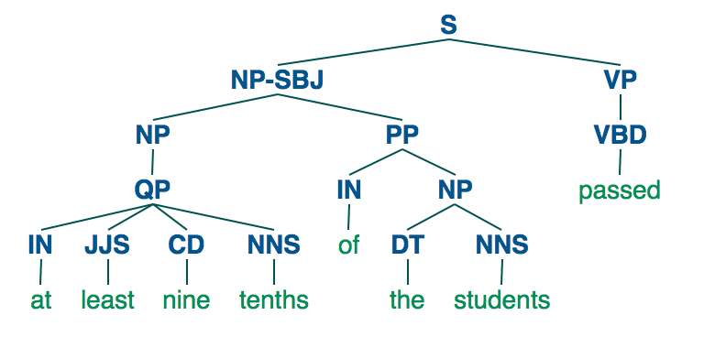
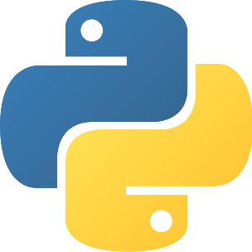
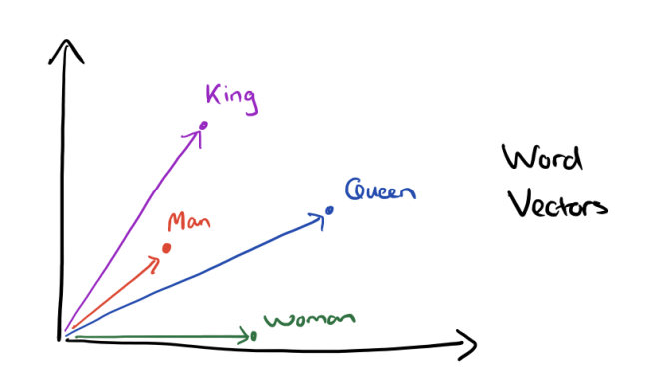


Slide 2

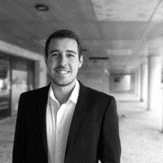

8 years of experience in data science related roles.
Based in Lisbon, Portugal.
Started in ETL/Databases, moved to Data Science and now I am a partner @ DareData Engineering, a portuguese startup.
Implemented some Natural Language Processing pipelines in large corporate customers.
Worked mostly in retail, banking and as a consultant.
Motivations for this course:
  To help introduce Natural Language Processing for beginners.
  Teach the fundamentals of NLP and provide solid knowledge on working with text in Python.
  Help entry level data scientists to understand what may be a future career path in NLP.
LinkedIn: https://www.linkedin.com/in/ivobernardo/
DareData website: https://daredata.engineering/home

Slide 3







Slide 4







Slide 5


